Slide 1
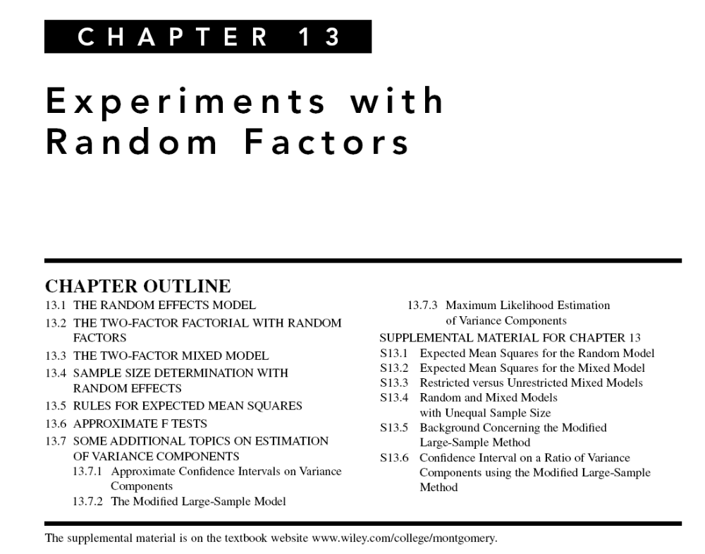

Slide 2
Design of Engineering Experiments -
Experiments with Random Factors
Text reference, Chapter 13
Previous chapters have considered fixed factors
  A specific set of factor levels is chosen for the experiment
  Inference confined to those levels
  Often quantitative factors are fixed (why?)
When factor levels are chosen at random from a larger population of potential levels, the factor is random
  Inference is about the entire population of levels
  Industrial applications include measurement system studies

Slide 3
Random Effects Models
Example 13.1 – weaving fabric on looms
Response variable is strength
Interest focuses on determining if there is difference in strength due to the different looms
However, the weave room contains many (100s) looms
Solution – select a (random) sample of the looms, obtain fabric from each
Consequently, “looms” is a random factor
See data, Table 13.1; looks like standard single-factor experiment with a = 4 & n = 4

Slide 4
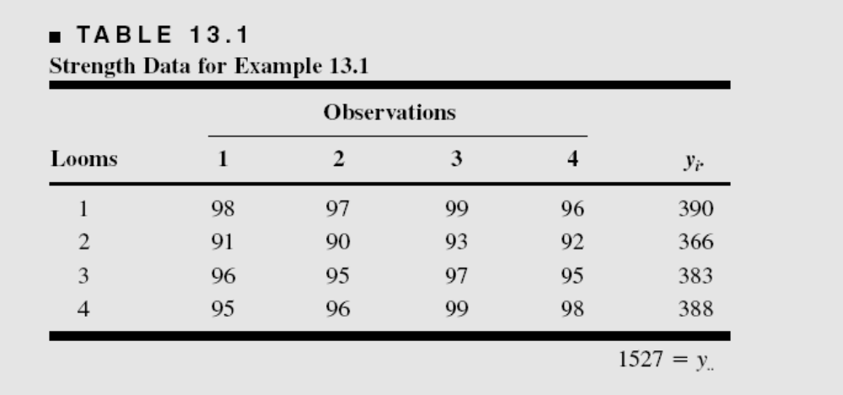

Slide 5
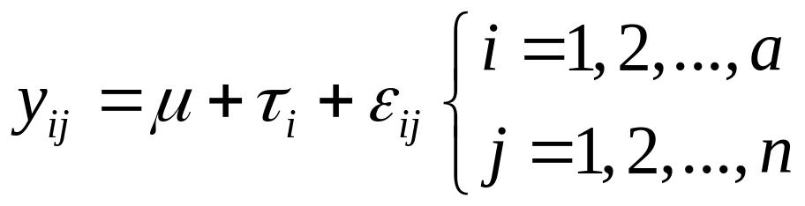
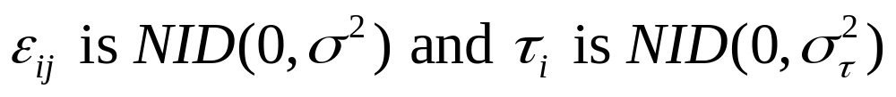
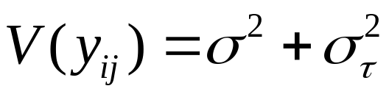
Random Effects Models
The usual single factor ANOVA model is
Now both the error term and the treatment effects are random variables:
Variance components:

Slide 6
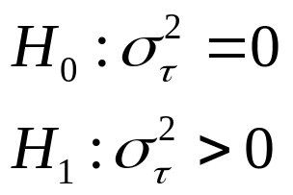
Relevant Hypotheses in the Random Effects (or Components of Variance) Model
In the fixed effects model we test equality of treatment means
This is no longer appropriate because the treatments are randomly selected
  the individual ones we happen to have are not of specific interest
  we are interested in the population of treatments
The appropriate hypotheses are

Slide 7
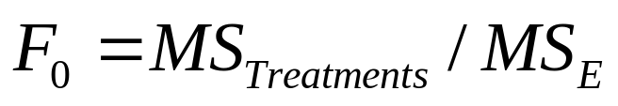
Testing Hypotheses - Random Effects Model
The standard ANOVA partition of the total sum of squares still works; leads to usual ANOVA display
Form of the hypothesis test depends on the expected mean squares
Therefore, the appropriate test statistic is

Slide 8
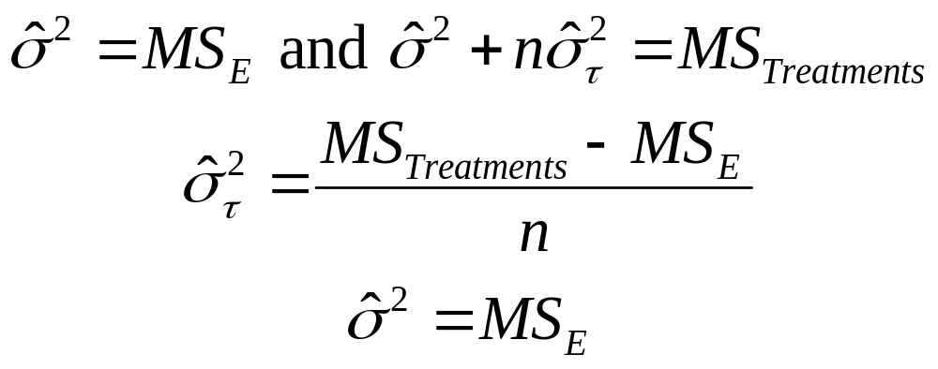
Estimating the Variance Components
Use the ANOVA method; equate expected mean squares to their observed values:
Potential problems with these estimators
  Negative estimates (woops!)
  They are moment estimators & don’t have the best statistical properties

Slide 9
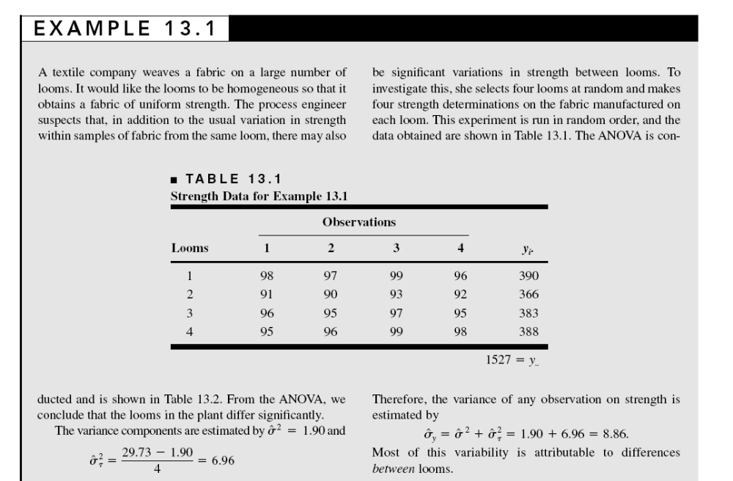

Slide 10
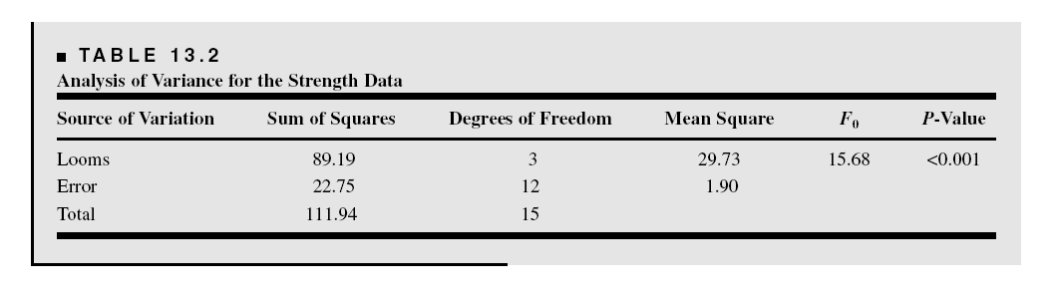
Either JMP or Minitab can be used to analyze the random effects model

Slide 11
Minitab Solution (Balanced ANOVA)
Factor Type Levels Values
Loom random 4 1 2 3 4
Analysis of Variance for y
Source DF SS MS F P
Loom 3 89.188 29.729 15.68 0.000
Error 12 22.750 1.896
Total 15 111.938
Source Variance Error Expected Mean Square for Each Term
component term (using unrestricted model)
1 Loom 6.958 2 (2) + 4(1)
2 Error 1.896 (2)

Slide 12
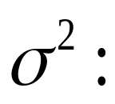
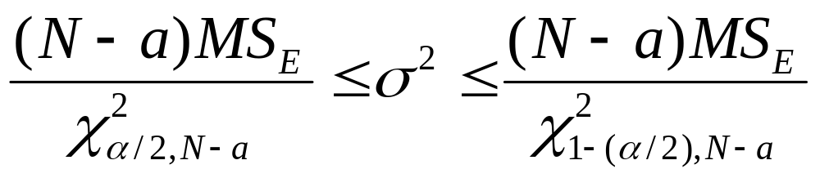
Confidence Intervals on the Variance Components
Easy to find a 100(1-α)% CI on
Other confidence interval results are given in the book
Sometimes the procedures are not simple

Slide 13
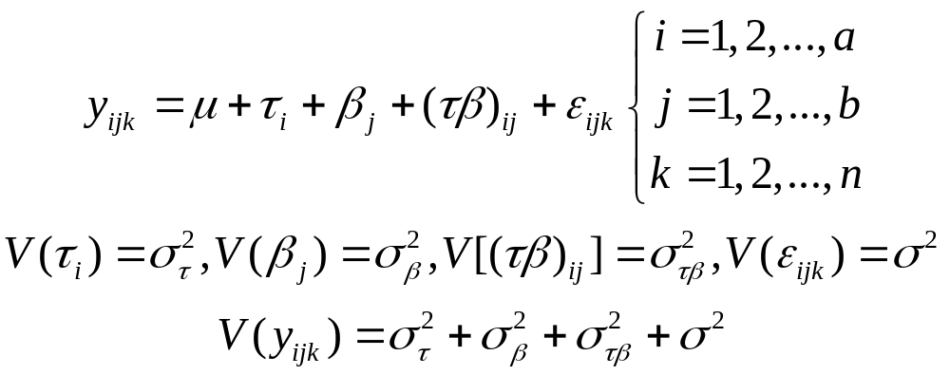
Extension to Factorial Treatment Structure
Two factors, factorial experiment, both factors random (Section 13.2, pg. 511)
The model parameters are NID random variables
Random effects model

Slide 14
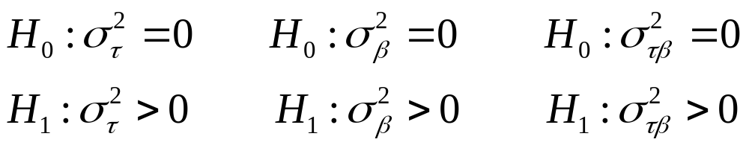
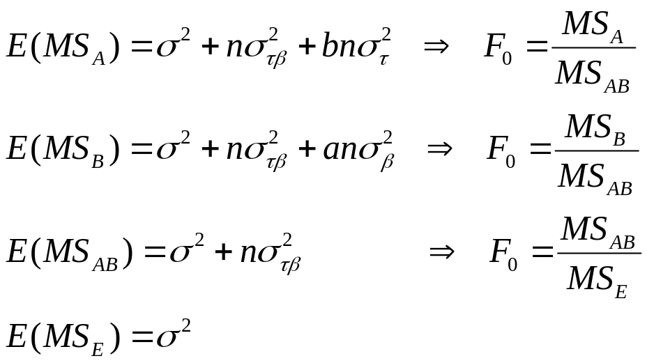
Testing Hypotheses - Random Effects Model
Once again, the standard ANOVA partition is appropriate
Relevant hypotheses:
Form of the test statistics depend on the expected mean squares:

Slide 15
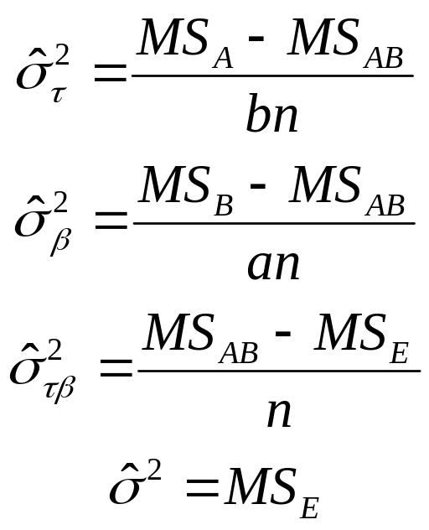
Estimating the Variance Components – Two Factor Random model
As before, use the ANOVA method; equate expected mean squares to their observed values:
Potential problems with these estimators

Slide 16
Example 13.2
A Measurement Systems Capability Study
Gauge capability (or R&R) is of interest
The gauge is used by an operator to measure a critical dimension on a part
Repeatability is a measure of the variability due only to the gauge
Reproducibility is a measure of the variability due to the operator
See experimental layout, Table 13.3. This is a two-factor factorial (completely randomized) with both factors (operators, parts) random – a random effects model

Slide 17
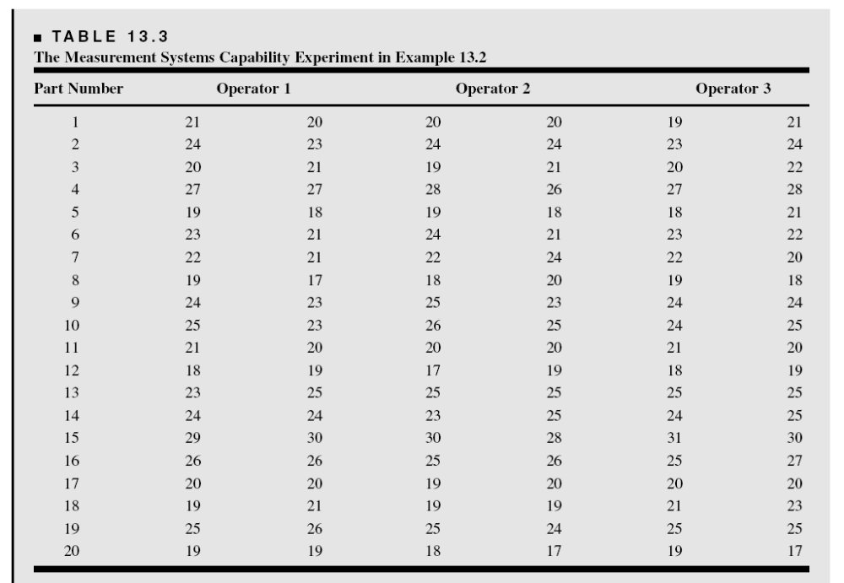

Slide 18
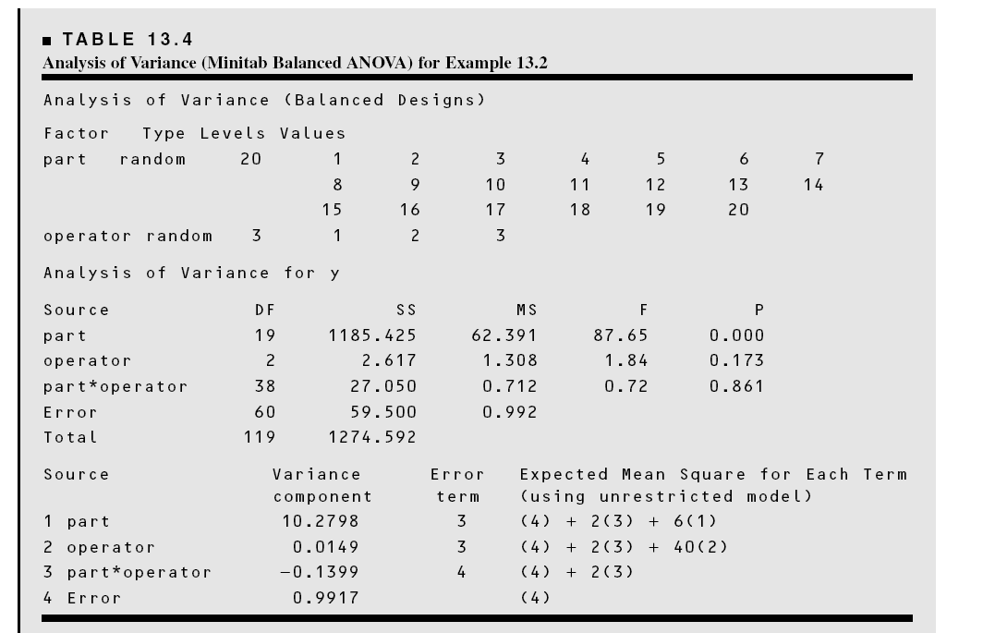
Example 13.2
Minitab Solution – Using Balanced ANOVA

Slide 19
Example 13.2
Minitab Solution – Balanced ANOVA
There is a large effect of parts (not unexpected)
Small operator effect
No Part – Operator interaction
Negative estimate of the Part – Operator interaction variance component
Fit a reduced model with the Part – Operator interaction deleted

Slide 20
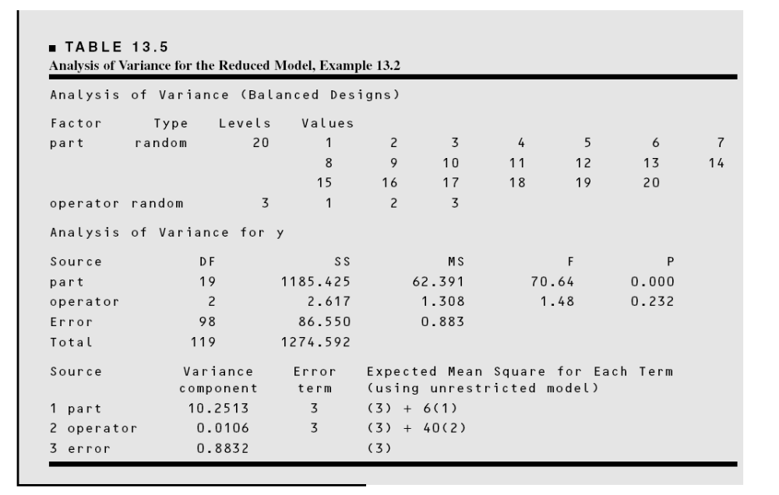
Example 13.2
Minitab Solution – Reduced Model

Slide 21
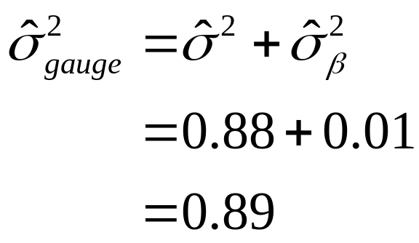
Example 13.2
Minitab Solution – Reduced Model
Estimating gauge capability:
If interaction had been significant?

Slide 22
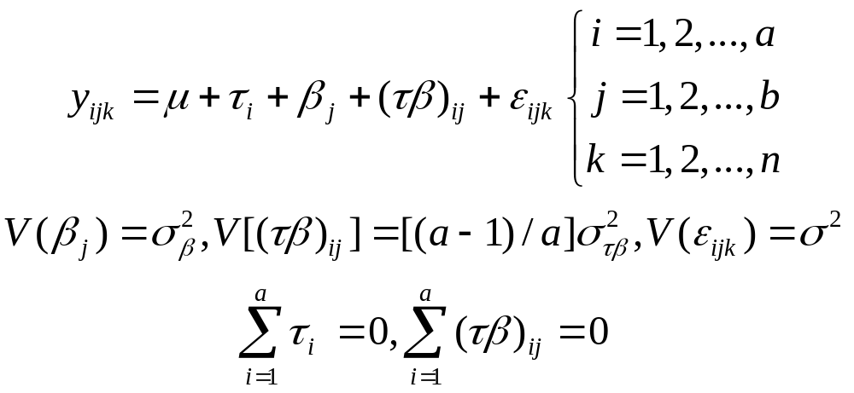
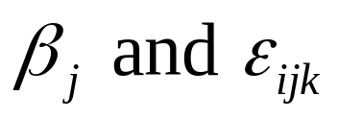
The Two-Factor Mixed Model
Two factors, factorial experiment, factor A fixed, factor B random (Section 13.3, pg. 515)
The model parameters are NID random variables, the interaction effect is normal, but not independent
This is called the restricted model

Slide 23
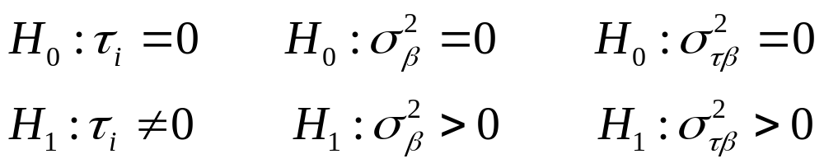
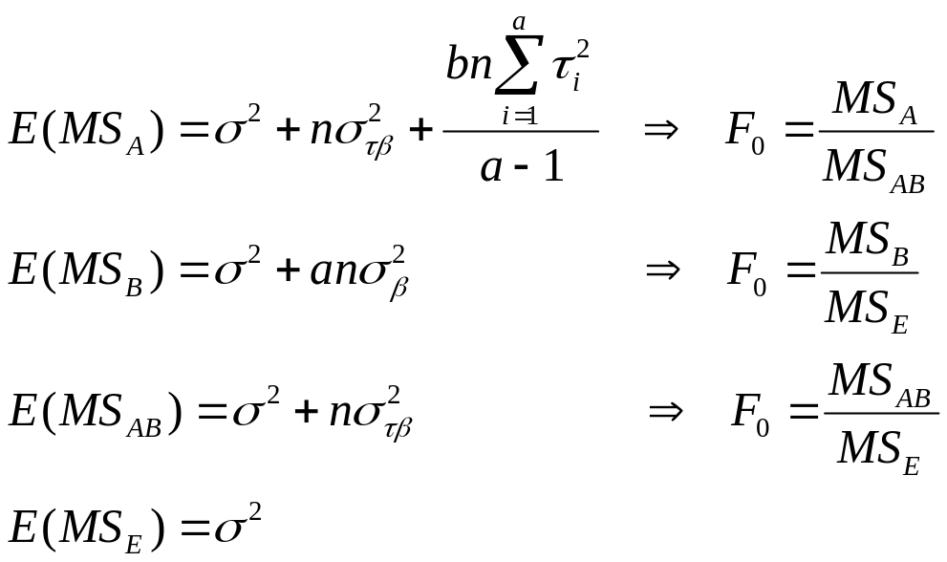
Testing Hypotheses - Mixed Model
Once again, the standard ANOVA partition is appropriate
Relevant hypotheses:
Test statistics depend on the expected mean squares:

Slide 24
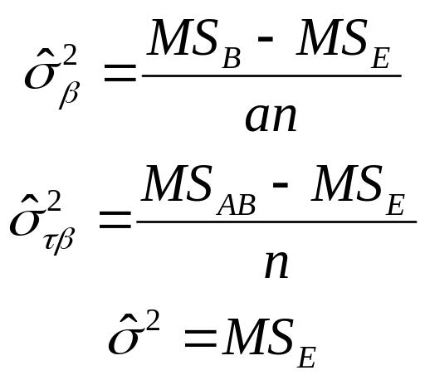
Estimating the Variance Components – Two Factor Mixed model
Use the ANOVA method; equate expected mean squares to their observed values:
Estimate the fixed effects (treatment means) as usual

Slide 25
Example 13.3
The Measurement Systems Capability Study Revisited
Same experimental setting as in example 13.2
Parts are a random factor, but Operators are fixed
Assume the restricted form of the mixed model
Minitab can analyze the mixed model

Slide 26
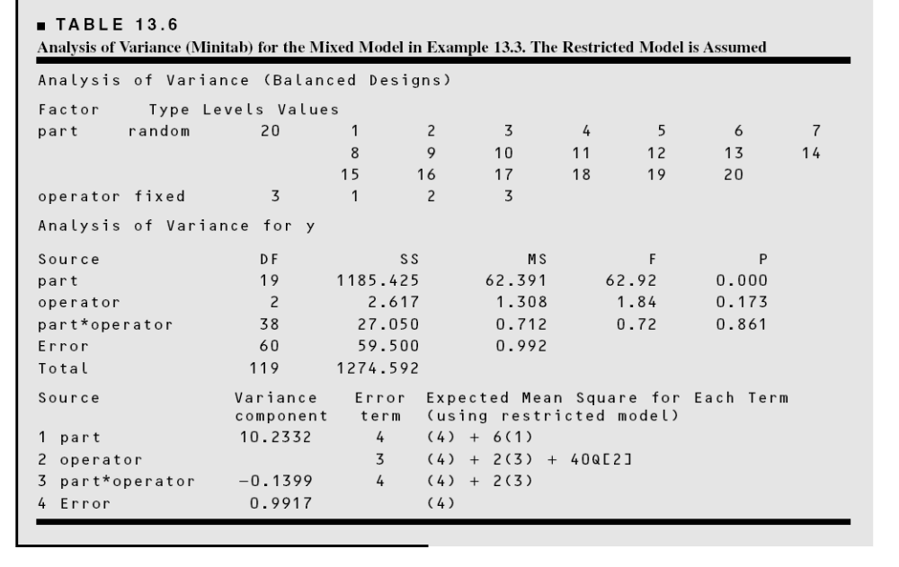
Example 13.3
Minitab Solution – Balanced ANOVA

Slide 27
Example 13.3
Minitab Solution – Balanced ANOVA
There is a large effect of parts (not unexpected)
Small operator effect
No Part – Operator interaction
Negative estimate of the Part – Operator interaction variance component
Fit a reduced model with the Part – Operator interaction deleted
This leads to the same solution that we found previously for the two-factor random model

Slide 28
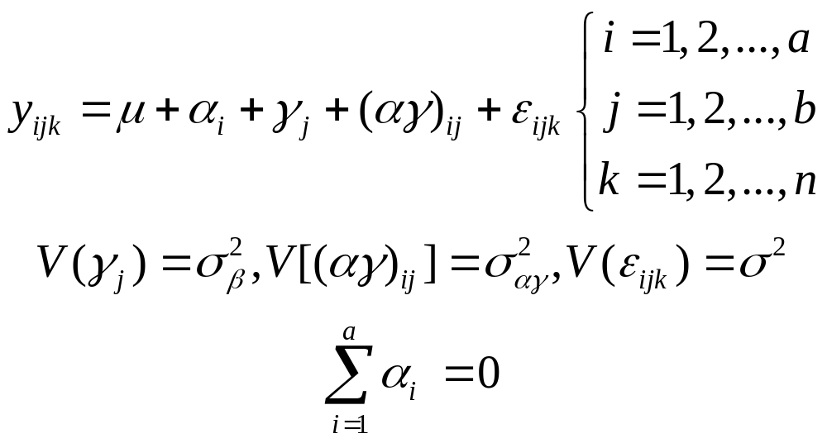
The Unrestricted Mixed Model
Two factors, factorial experiment, factor A fixed, factor B random (pg. 518)
The random model parameters are now all assumed to be NID

Slide 29
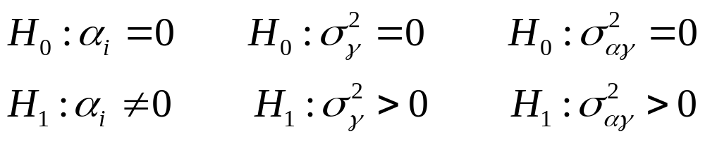
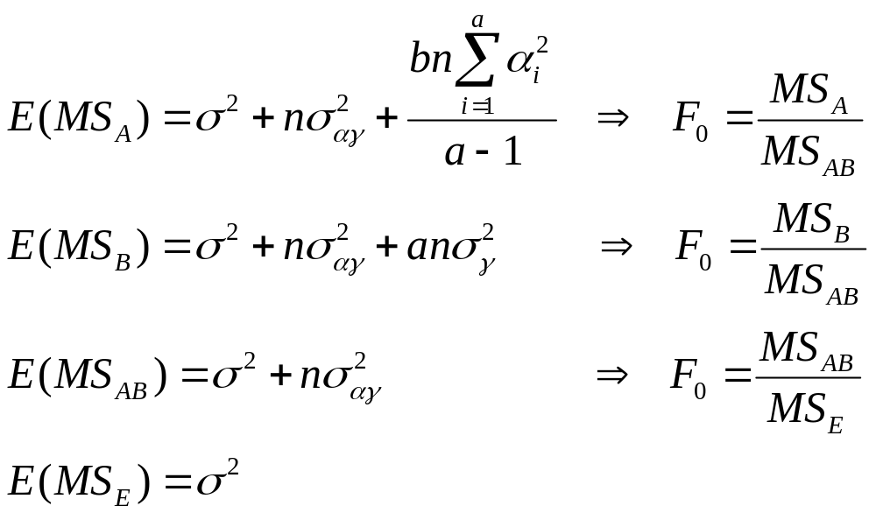
Testing Hypotheses – Unrestricted Mixed Model
The standard ANOVA partition is appropriate
Relevant hypotheses:
Expected mean squares determine the test statistics:

Slide 30
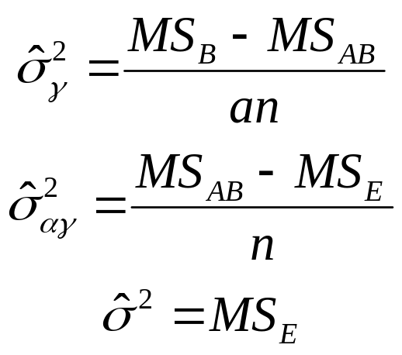
Estimating the Variance Components – Unrestricted Mixed Model
Use the ANOVA method; equate expected mean squares to their observed values:
The only change compared to the restricted mixed model is in the estimate of the random effect variance component

Slide 31
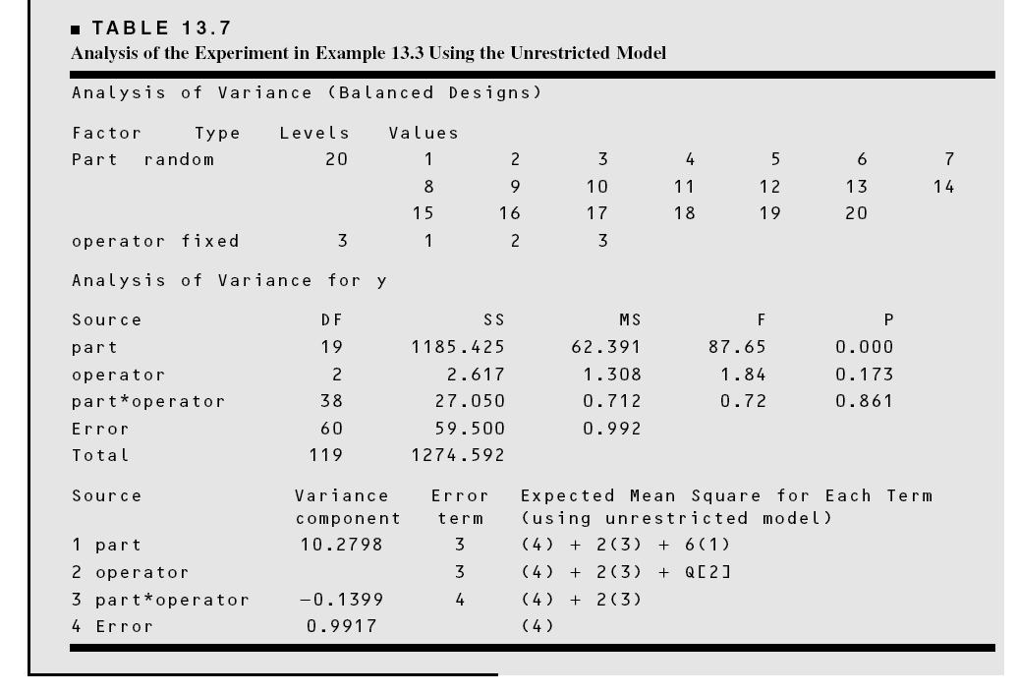
Example 13.4
Minitab Solution – Unrestricted Model

Slide 32
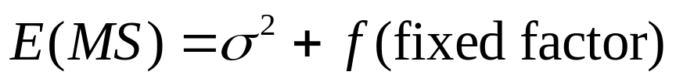
Finding Expected Mean Squares
Obviously important in determining the form of the test statistic
In fixed models, it’s easy:
Can always use the “brute force” approach – just apply the expectation operator
Straightforward but tedious
Rules on page 523-524 work for any balanced model
Rules are consistent with the restricted mixed model – can be modified to incorporate the unrestricted model assumptions

Slide 33
Approximate F Tests
Sometimes we find that there are no exact tests for certain effects (page 525)
Leads to an approximate F test (“pseudo” F test)
Test procedure is due to Satterthwaite (1946), and uses linear combinations of the original mean squares to form the F-ratio
The linear combinations of the original mean squares are sometimes called “synthetic” mean squares
Adjustments are required to the degrees of freedom
Refer to Example 13.7
Minitab will analyze these experiments, although their “synthetic” mean squares are not always the best choice

Slide 34
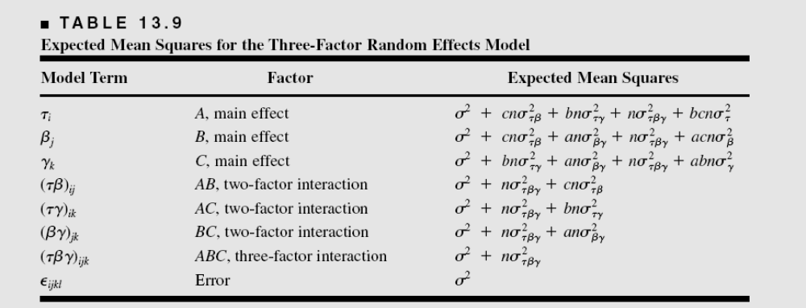
Notice that there are no exact tests for main effects

Slide 35
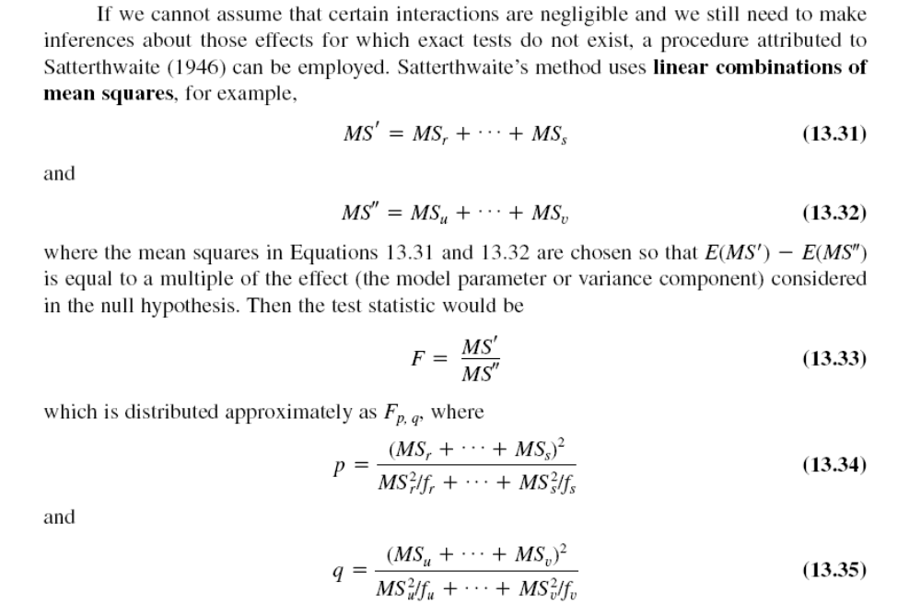

Slide 36
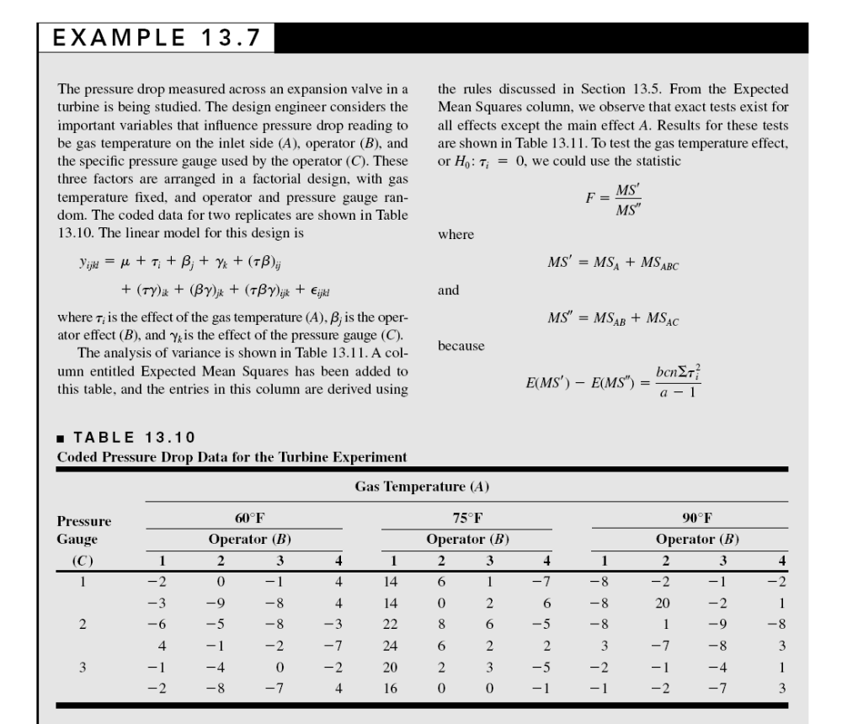

Slide 37
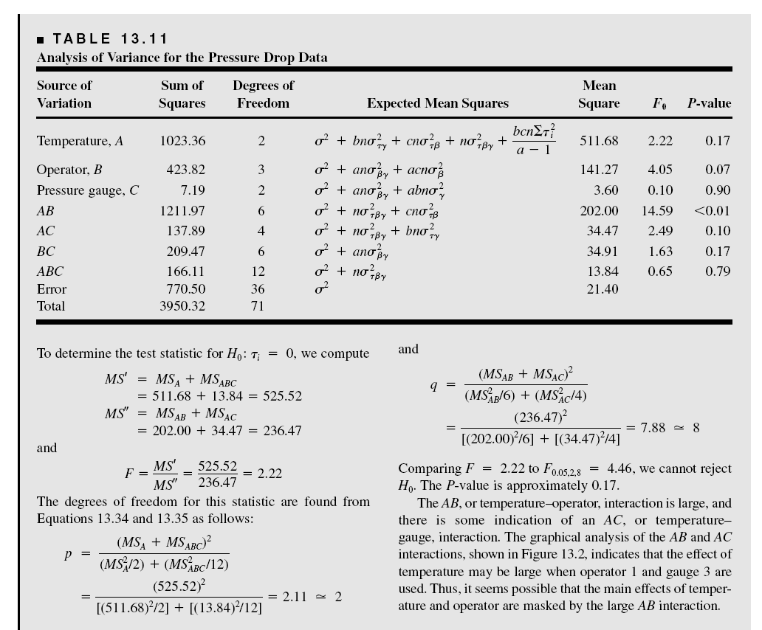

Slide 38
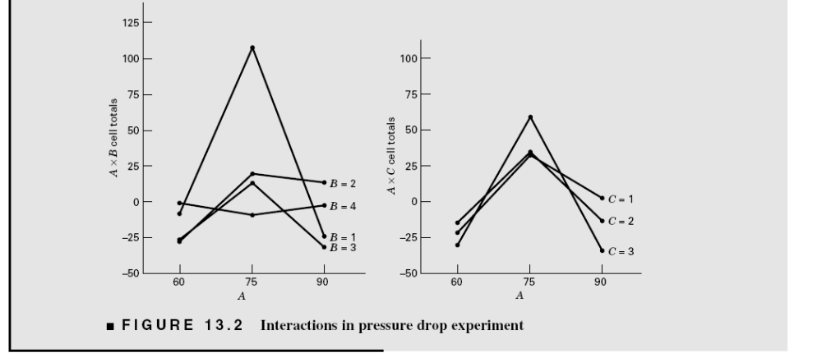

Slide 39
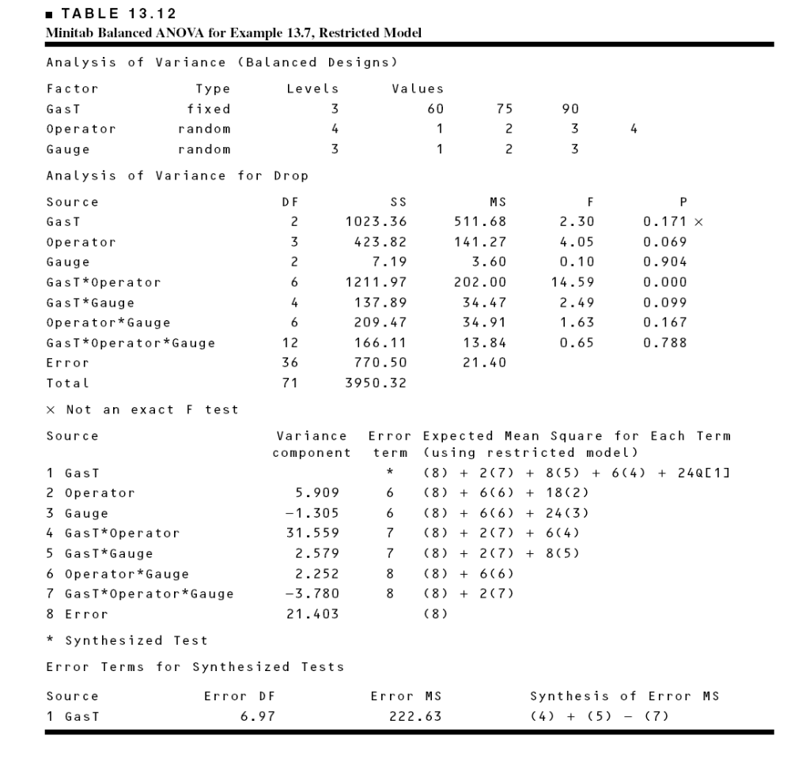
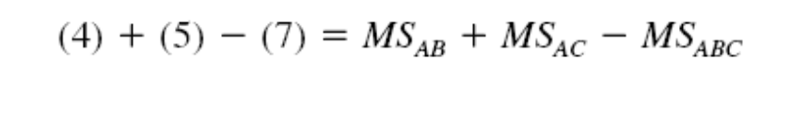
We chose a different linear combination

Slide 40
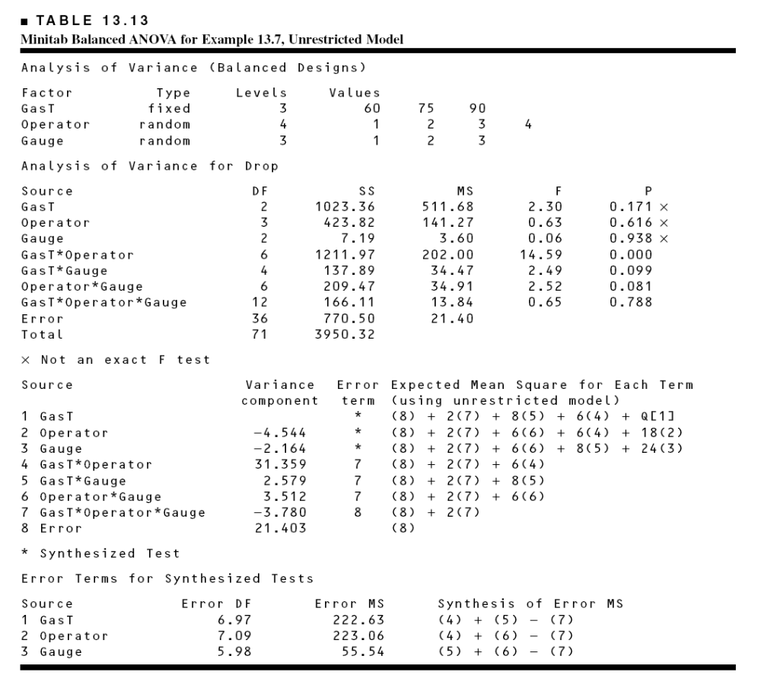

Slide 41
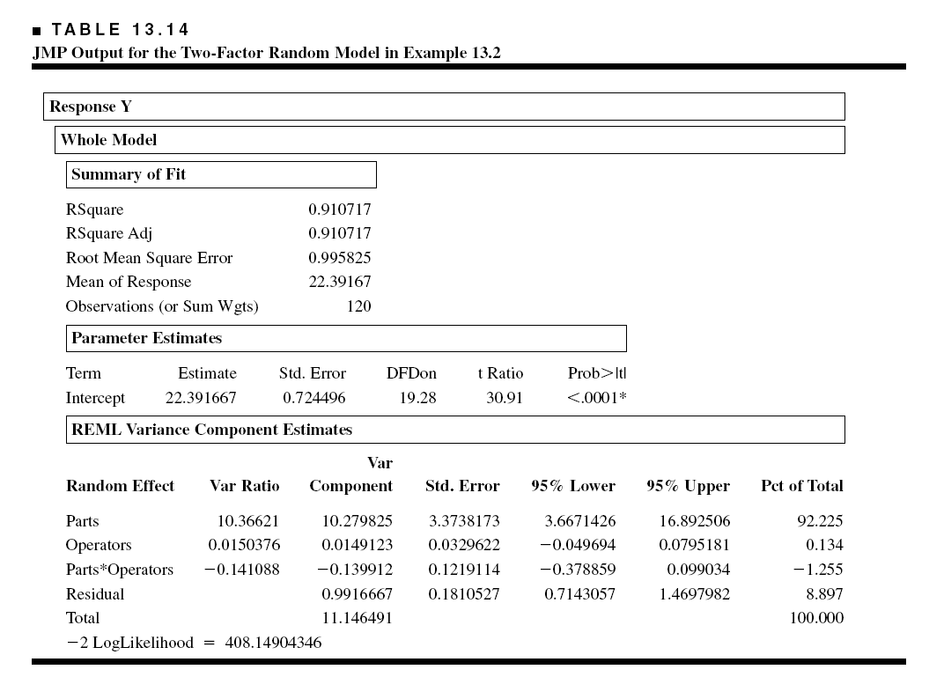
JMP uses a maximum likelihood approach to analyzing models with random factors

Slide 42
